Slide 1

Data Analysis
Sales store analysis Using python & pandas By : Jim Cepha

Slide 2

Problem Statement
Data regarding Sales, Profit etc.. across different Categories and Regions were given to us by a Sales Store.
And we have to Analyze the Data and provide the Stakeholders with Insights to Improve their Business Performance.
They want to know which Category of Products are most Profitable, which Region has the most Sales and Profit, and what are the most Profitable Products.

Slide 3
Assumptions
Assuming that the Data Provided is Accurate and has all Samples of Transactions of the Store.
Also, assuming that the Data is sufficient to find Patterns in Sales and Profitability.
Also assuming that the Data is not impacted by any Significant Outliers that could Skew the Analysis.

Slide 4
Research Questions
1. Which Product Categories have the Highest Profit Margin ?
2. Are there any significant differences in Sales between East region and other Regions ?
3. How do the Sales vary by Product Category during different Months of the Year ?
4. What is the rate of Returned Products for orders with same-day shipping, compared to other Shipping modes ?
5. How to Sales and Profit vary by Product categories on Weekdays compared to Weekends ?

Slide 5
Hypotheses
(Assuming these to hold True, after analyzing...will Accept or Reject these Hypotheses)
Hypothesis 1: 'Technology' category Products have the Highest Profit Margin compared to other Categories.
Hypothesis 2: 'East' Region has the Highest Sales compared to other Regions.
Hypothesis 3: Sales are higher during certain Months of the Year.
Hypothesis 4: Orders with 'Same Day' shipping have lowest rate of Returned Products.
Hypothesis 5: The Company's profit is more on Weekdays than on Weekends.

Slide 6
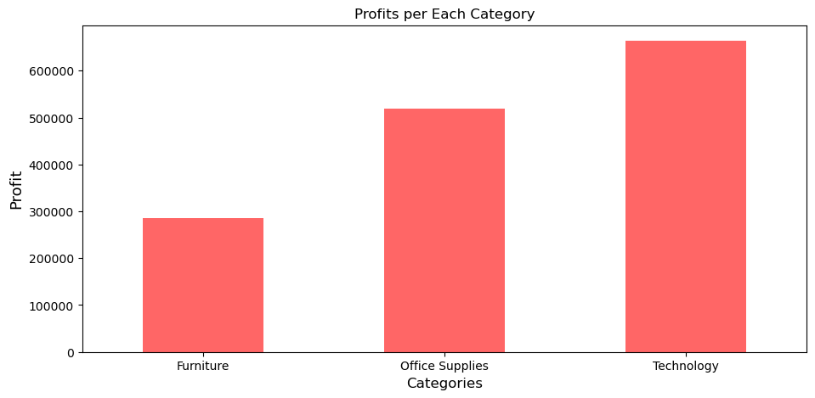
Hypothesis 1: 'Technology' category products have the Highest Profit Margin compared to other Categories. Conclusion : This Hypothesis is proved to be True. The Data shows that the 'Technology' Products have the Highest Profit Margin compared to the other Products.

Slide 7
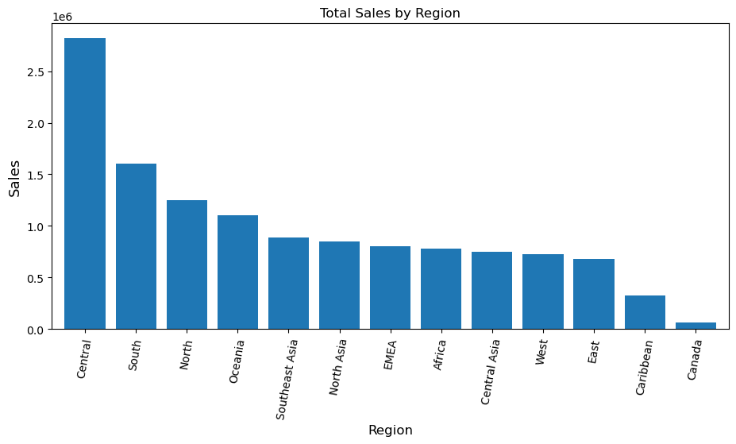
Hypothesis 2: 'East' Region has the Highest Sales compared to other Regions. Conclusion : This Hypothesis is Proved to be False, as the Data shows that the East Region does not have the Highest Sales compared to other Regions.

Slide 8
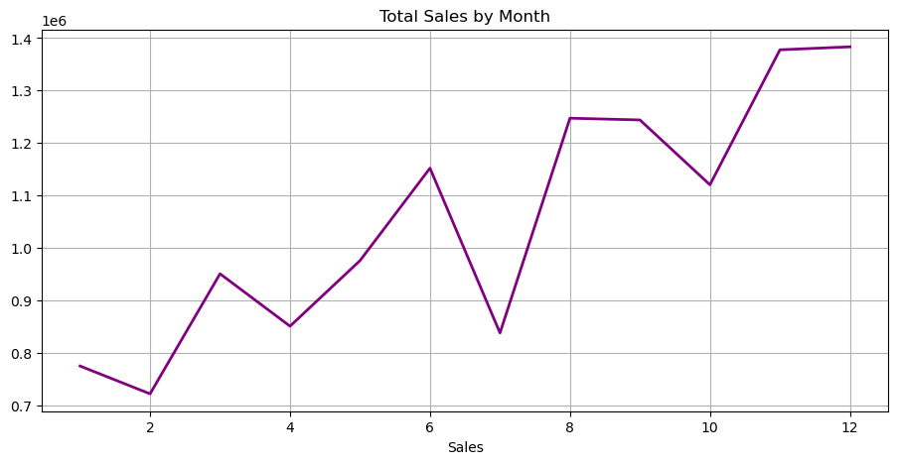
Hypothesis 3: Sales are higher during certain Months of the Year. Conclusion : This Hypothesis is Proved to be True. The Data shows that Sales are Higher during certain Months of the Year.

Slide 9
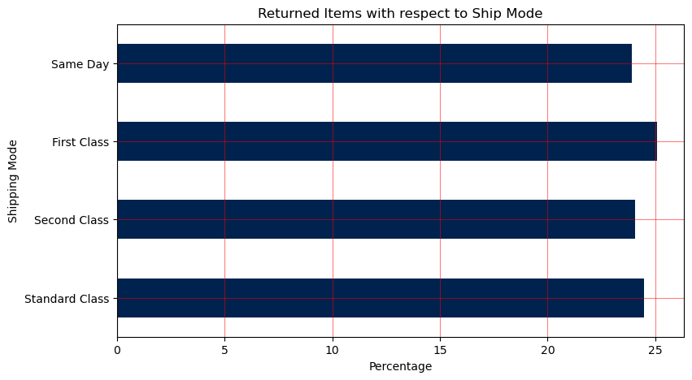
Hypothesis 4: Orders with 'Same Day' shipping have lowest rate of Returned Products. Conclusion : This Hypothesis is Proved to be True. The Data shows that the Orders with 'Same Day’ shipping have lowest rate of Returned Products.

Slide 10
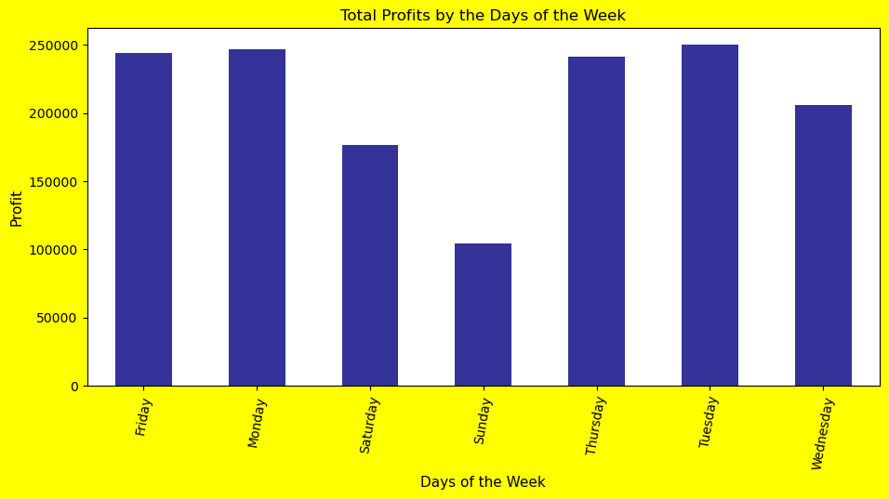
Hypothesis 5: The Company's profit is more on Weekdays than on Weekends. Conclusion : This Hypothesis is Proved to be True. The Data shows that the Company’s Profit is more on Weekdays than on Weekends.

Slide 11
Results
Based on the Analysis, it is concluded that - 'Technology' Products have the Highest Profit.
Margin compared to the other Products.
The 'East' Region does not have the Highest Sales but the 'Central' Region does.
Sales are Higher during certain Months of the Year.
Orders with same-day Shipping are less likely to be Returned.
The Company's Profit is Higher on Weekdays than on Weekends.

Slide 12
Suggestions
The Company can increase the Production/ Promotion of ‘Technology’ Products to increase their Profitability.
As the 'Central' Region has the Highest Sales compared to other Regions, the Company could consider Increasing their focus on this Region, and should Re-evaluate it’s Marketing & Sales Strategies in other Regions.
The Company should focus on Maximizing their Sales during the Months of November and December as these Months have the Highest Sales. However, the Company should also consider Strategies to maintain Sales during other Months by introducing New Products, Services, Offers, Discounts, etc.
It would be Profitable for the Company to consider offering more Same-Day Shipping options to Customers, as these Products have the Lowest possibility to be Returned by the Customer.
Additionally, the Company should consider Focusing of different types of Sales/ Promotions/ Offers/ Discounts during the Weekends to increase Sales, as Weekends are having Lower Sales than Weekdays.

Slide 13
Created by: Jim Cepha
Just hire me already !
Contact Info :
Phone: +91 8522097007 Email: jimcepha@gmail.com

